Slide 1
Lesson 1

Slide 2
Topic Distributive Law EQ: How do I expand binomial brackets?

Slide 3

Topic Distributive Law EQ: How do I expand binomial brackets?
Expanding: Single pair of brackets
$3x(x+5y)$ =
$3x×x + 3x×5y$=
$$3x^{2}+15xy$$
Distributive Law:
a(b + c) =
a x b + a x c =
ab + ac

Slide 4
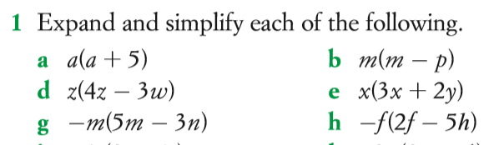
Your go…

Slide 5
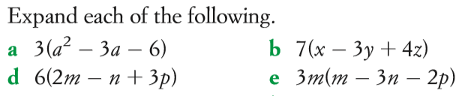
Little bit harder…
Same rules apply as before!
a (b + c + d)=
a x b + a x c + a x d =
ab + ac + ad

Slide 6

Topic Distributive Law EQ: How do I expand binomial brackets?
$\left(x+7\right)\left(x+9\right)=$
$x^{2}+16x+63$
Expanding: Binomial brackets
Two available methods:
Table method
FOIL method

Slide 7
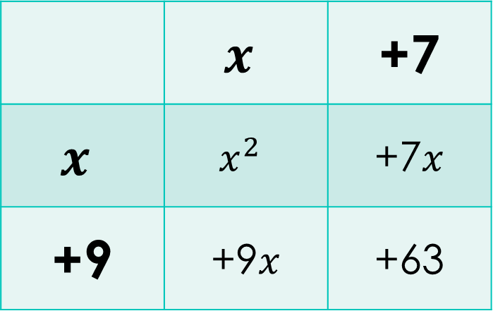


Topic Distributive Law EQ: How do I expand binomial brackets?
Binomial brackets: Table method
$\left(x+7\right)\left(x+9\right)=$
 | $$x$$ | +7
$$x$$ | $$x^{2}$$ | +7$x$
+9 | +9$x$ | +63
$$=x^{2}+7x+9x+63$$
$$=x^{2}+16x+63$$

Slide 8

Binomial brackets: FOIL method
Topic Distributive Law EQ: How do I expand binomial brackets?
$$\left(x+7\right)\left(x+9\right)=$$
F = ${x×x=x}^{2}$
O = $x×9=9x$
I = $x×7=7x$
L = $7×9=63$
→$x^{2}+9x+7x+63=$
$x^{2}+16x+63$
F → First terms
O → Outside terms
I → Inner terms
L → Last terms

Slide 9
You try…

Slide 10
Lesson 2

Slide 11
Topic Reverse distributive Law EQ: How do I factorise?

Slide 12
Factorising: Reverse distributive law
Find HCF
Find the highest common factor (HCF)
Rewrite
Rewrite the equation with each term as a product of the HCF
Factor out
Factor out the HCF

Slide 13

Factorising: Reverse distributive law
Topic Reverse distributive Law EQ: How do I factorise?
$12p+18$ =
$6×2p +6×3$=
$6(2p+3)$
Distributive Law:
a(b + c) =
a x b + a x c =
ab + ac
REVERSE Distributive Law:
ab + ac
a x b + a x c =
a(b + c) =

Slide 14
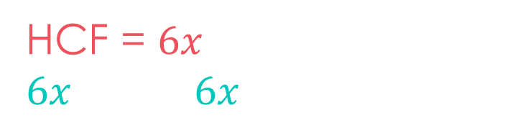
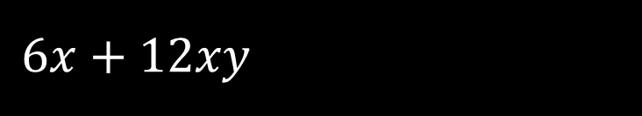

Here’s another example…
$$6x+12xy$$
The HCF can include a variable
HCF = $6x$
$$6x×1+6x×2y$$
$$6x(1+2y)$$

Slide 15
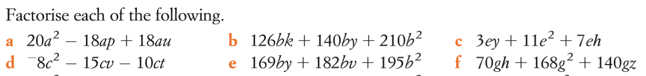
You try…

Slide 16
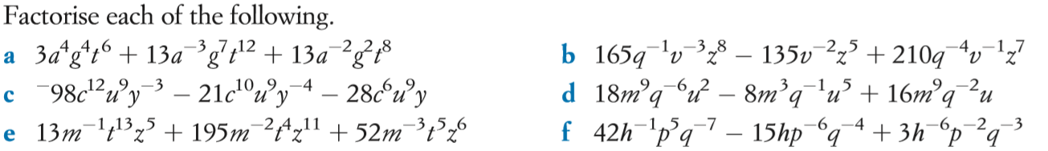
Little bit harder…

Slide 17
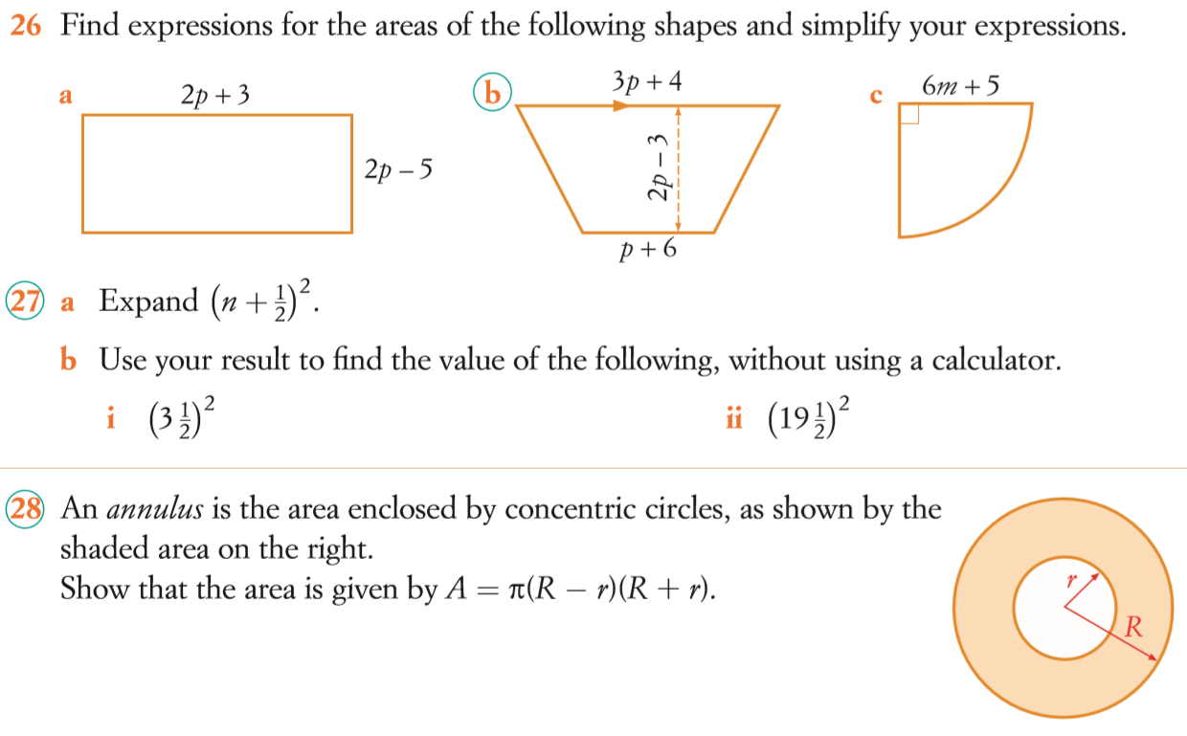

Challenge questions

